Slide 1
Software Preservation:
Building a Community of Research Practitioners
Alexandra Chassanoff and Wendy Hagenmaier
Society of American Archivists Research Forum
July 25th, 2017
Notes:
Hi, everyone! [introduce ourselves]
In this talk, we’d like to share updates from the Software Preservation Network and invite you all to get involved.

Slide 2
SPN: Saving Software Together
Mission: Preserving software through community engagement, infrastructure support, and knowledge generation
Connects legal, public policy, social science, natural science, IT, and cultural heritage preservation communities
softwarepreservationnetwork.org https://osf.io/a7uea/
Notes:
The mission of the Software Preservation Network (affectionately known as SPN) is to preserve software through community engagement, infrastructure support, and knowledge generation. SPN coordinates software preservation efforts and brings together stakeholders from many different disciplines and perspectives.

Slide 3
SPN: Timeline
2014
2015
2016
2017
Presentation on SPN concept at SAA
IMLS Funding, Working Groups
IMLS Funding, Research study,
National Forum
Cyberlaw Partnership,
SPN Forum,
Community Roadmap
softwarepreservationnetwork.org https://osf.io/a7uea/
Notes:
Jessica Meyerson, Carlos Ovalle, and Zach Vowell introduced SPN during a presentation at SAA in 2014, conducted a study in 2015, and organized a forum at SAA in 2016 -- a roadmap emerged out of that forum, as well as several community-driven working groups.

Slide 4
SPN: Working Groups
Curation-readiness
Research
Metadata/Standards
Communication
Technical Infrastructure
Legal/Policy
Documentation
softwarepreservationnetwork.org https://osf.io/a7uea/
Notes:
There are currently 7 active working groups in the SPN. We’d like to share quick updates from two of the Working Groups, but our slides also cover updates from the other five groups in case you’re interested in looking at them on your own (they’re up on our OSF site, which is the link in the bottom corner of the slides and we’ll have a direct link to the slides at the end).

Slide 5
Curation-Readiness Working Group
Scope: Provides guidance, framed by use cases, for making software repositories more useable by improving software’s “curation readiness”
Recent work: Developed a set of use cases to explore curation readiness: http://doi.org/10.17605/OSF.IO/8RZ9E
Members: Fernando Rios, Bridget Almas, Alex Chassanoff, Nicole Contaxis, Paula Jabloner, Heidi Kelly
softwarepreservationnetwork.org https://osf.io/a7uea/
Notes:
Curation Readiness recently published a set of use cases to explore curation strategies for making software accessible, preservable and useable. They are seeking additional use cases, so please get in touch if you’d like to submit one.

Slide 6
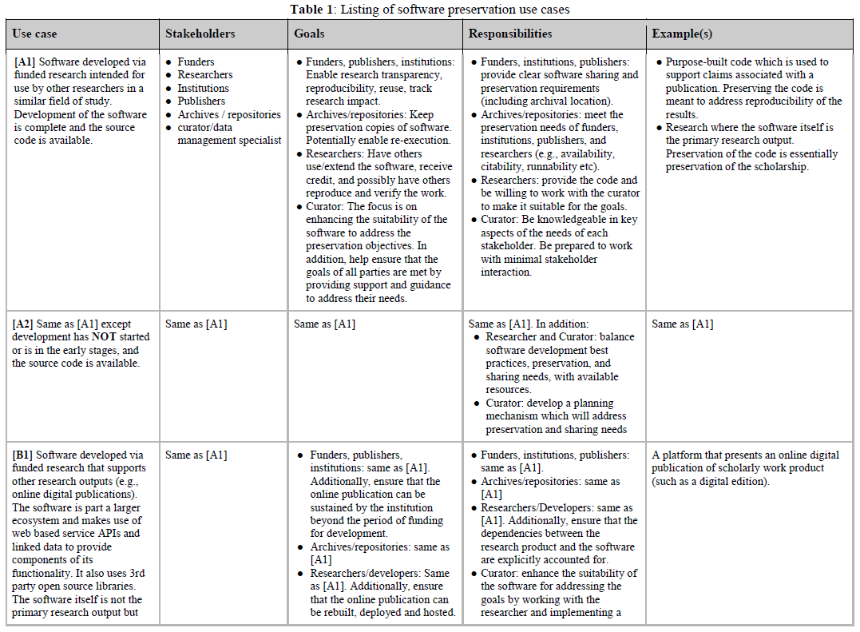
Software Preservation Use Cases
http://doi.org/10.17605/OSF.IO/8RZ9E
softwarepreservationnetwork.org https://osf.io/a7uea/

Slide 7
Research Working Group
Scope:
Facilitates research projects that bring individuals and organizations with diverse perspectives together to document and analyze the landscape of software preservation and access
Aims to explore frameworks for sustainable, transparent, community-based research and to advocate for innovative models of research that accelerates practice
Members: Alex Chassanoff, Cynde Moya, Christa Williford, Jessica Meyerson, John Borghi, Katherine Thornton, Wendy Hagenmaier, Yasmin AlNoamany
softwarepreservationnetwork.org https://osf.io/a7uea/
Notes:
The Research Group facilitates projects that bring individuals and organizations with diverse perspectives together to document and analyze the landscape of software preservation and access. We aim to develop frameworks for sustainable, transparent, community-based research and to advocate for innovative models of research that accelerates practice.

Slide 8
Ontology of Software Preservation Research Questions: https://osf.io/3jpqp/
Definitions
How can “software,” “software curation,” “software preservation,” and “software access” be defined, and how do the definitions matter?
Who and What
What institutions/organizations/communities/individuals are collecting, curating, preserving, and providing access to software, and what software are they collecting, curating, preserving, and making accessible?
What software registries exist, and what are they focusing on/asking for currently?
Why
What are the use cases for collecting, curating, preserving, and providing access to software, now and in the future?
softwarepreservationnetwork.org https://osf.io/a7uea/
Notes:
Over the past few months, Research has been collaborating on an ontology of research questions related to software preservation, along with citations for existing research that explores each question. The ontology is not meant to be a comprehensive listing of all research in the software preservation domain; rather, it’s intended to offer an entrance point into selected research and to empower the Working Group to identify gaps where additional research could be done.
The ontology clusters software preservation research questions into several large categories, including definitions, who and what, why...

Slide 9
Ontology of Software Preservation Research Questions: https://osf.io/3jpqp/
How
What workflows are currently being used to collect, preserve, curate, and provide access to software and what might future state workflows look like?
What skillsets are needed to collect, preserve, curate, and provide access to software?
What policies currently exist around preserving, curating, and providing access to software and what might future state policies look like?
What metadata schemas/vocabularies currently exist for describing software, and what are the gaps in the software metadata landscape?
How can the quality of software preservation be assessed?
What ethical questions exist regarding software preservation and curation?
softwarepreservationnetwork.org https://osf.io/a7uea/
Notes:
...and how. We identified several gaps in the existing research landscape, where additional research would be very beneficial to the community.

Slide 10
Ontology of Software Preservation Research Questions: https://osf.io/3jpqp/
Gaps in Existing Research:
Need for data about which institutions are preserving software
Need for research into (international and national) policy surrounding software preservation
How are researchers using software in archival institutions to ask new questions or find new answers to old questions?
Need for additional exploration of ethical issues surrounding software preservation
Need for additional exploration of metadata best practices
Need for additional work to develop measures of preservation quality
softwarepreservationnetwork.org https://osf.io/a7uea/
Notes:
Gaps include the need for data about which institutions are preserving software, for research about policy, researcher use cases, ethics, metadata, and quality, among others.

Slide 11
Next Steps: Developing A Research Toolkit (we want you!)
A set of templates and research instruments that individuals can use to gather data about software preservation in their local organization or community
Individuals will be encouraged to contribute their data back to SPN
The Working Group will analyze the data in aggregate and map the landscape of software preservation over time
softwarepreservationnetwork.org https://osf.io/a7uea/
Notes:
With these gaps in mind, the Working Group will create template research instruments that individuals could use to gather data about software preservation in their local organizations or communities. The individuals will be encouraged to contribute their data back to the SPN Research Working Group, who will analyze the data in aggregate and attempt to map the landscape of software preservation over time.

Slide 12
Metadata Working Group
Scope: Develops and promotes common metadata frameworks to support software preservation and discovery
Recent work: Survey about metadata used in software preservation; crosswalk of software metadata ontologies
Members: Elizabeth Russey Roke, Glynn Edwards, Wendy Hagenmaier, Paula Jabloner, Daniel Noonan, Katherine Thornton, Tim Walsh
softwarepreservationnetwork.org https://osf.io/a7uea/
Notes:
The Metadata Group’s recent work includes conducting a survey about metadata practices used in software preservation and developing a crosswalk of software metadata ontologies.

Slide 13
Communication Working Group
Scope: Focuses on communications and outreach for SPN, to ensure the larger community is aware of the work being done and priorities SPN is making
Recent work: Publishing blog posts, twitter (@SoftPresNetwork - follow us!)
Members: Aliza Leventhal, Andrew Berger
softwarepreservationnetwork.org https://osf.io/a7uea/
Notes:
The Communication Group has been publishing blog posts and tweeting -- follow us at SoftPresNetwork!

Slide 14
Technical Infrastructure Working Group
Scope: Ensures that technology solutions proposed by SPN are as technically feasible as possible
Recent work: Exploring the creation of “reference implementations” of certain operating systems
Coordinator: Steve Marks
softwarepreservationnetwork.org https://osf.io/a7uea/
Notes:
The Technical Infrastructure Group is exploring the creation of “reference implementations” of operating systems and the feasibility of potential technology solutions SPN might pursue.

Slide 15
Legal/Policy Working Group
Scope: Explores licensing and information policy and develops a legal approach to software preservation and reuse
Recent work: Partnership with Harvard’s Cyberlaw Clinic and legal experts in the library world, including case law research, use case development, and copyright advocacy
Coordinator: Zach Vowell
softwarepreservationnetwork.org https://osf.io/a7uea/
Notes:
The Legal/Policy Group has been working with Harvard’s Cyberlaw Clinic and other legal experts in the library world to conduct case law research, develop use cases, and engage in advocacy around copyright issues.

Slide 16
Documentation Working Group
Scope: Ensures that all SPN research work and output is well managed and publicly accessible
Recent work: Established a public Open Science Framework repository for SPN
Members: Tim Walsh, Fernando Rios
softwarepreservationnetwork.org https://osf.io/a7uea/
Notes:
The Documentation Group set up our Open Science Framework repo -- check it out!

Slide 17
Governance Working Group
Scope: Establishes procedures to coordinate ongoing decision-making in anticipation and support of a more formal governance framework for SPN
Recent work: Research into organizational and funding models; creation of processes to continually solicit community priorities; identification of strategic partnerships
Members: Jessica Meyerson, Zach Vowell, Aliza Leventhal, Brandon Butler, Chip German, Euan Cochrane, Susan Malsbury, Nicholas Taylor
softwarepreservationnetwork.org https://osf.io/a7uea/
Notes:
The Governance group is developing organizational and funding models for SPN, towards the goal of a more formal governance framework.

Slide 18
Join Us!
Alexandra Chassanoff
achass@mit.edu
Wendy Hagenmaier
wendy.hagenmaier@gmail.com
@SoftPresNetwork
These slides: http://bit.ly/spn-saa2017
softwarepreservationnetwork.org https://osf.io/a7uea/
Notes:
The toolkit is a big exciting project, so we’re recruiting additional team members! If you’re interested in working on the Research Toolkit or any of the Working Group projects or providing input, we’d love it if you would get in touch with us!

